Slide 1
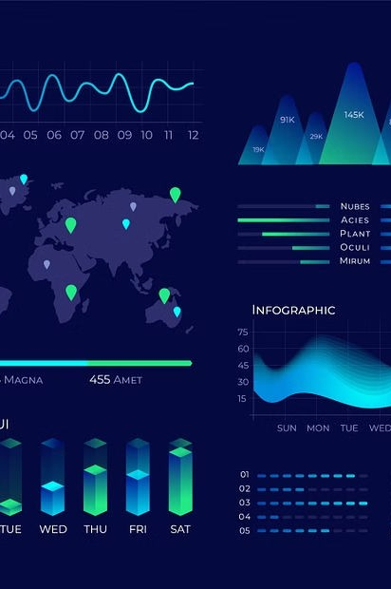
Data Visualization Tools
BY : SOURABH SINGH
CLASS : BCA 2(M)
ENROLL NO. : 03414202023

Slide 2
INDEX
What is data..?
Data Visualization Tools
Importance of Data Visualization Tools
Factors to Consider When Choosing a Data Visualization Tool
Types of Data Visualization Tools
Tableau: Features and Capabilities
Power Bi: Features and Capabilities
Comparison Table of Tableau and Power BI
Other Data Visualization tools
Conclusion and Final Thoughts

Slide 3
What is Data..?
Data is plays a role of paramount significance in the digital era. It is the fuel that drives the digital economy and powers the technologies that we use every day. Data is used to improve decision-making, create new products and services, improve operational efficiency, personalize the customer experience, and monetize data.
Data helps in :-
Improving decision-making.
Creating new products and services.
Improving operational efficiency.
Therefore, we need data visualization tools to analysis and interpret the simple or complex data easily.

Slide 4
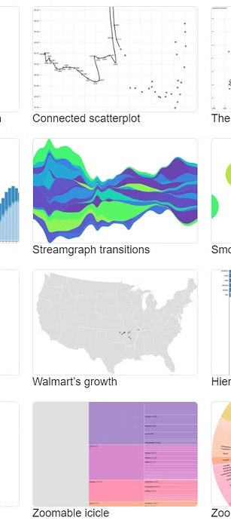
Data Visualization Tools
Data visualization is the graphical representation of information and data. By using visual elements like charts, graphs, and maps. Data visualization tools provide an accessible way to see and understand trends, outliers, and patterns in data. Additionally, it provides an excellent way for employees or business owners to present data to non-technical audiences without confusion.
Data visualization tools are essential for transforming data into actionable insights. They enable organizations to make informed decisions and identify trends.

Slide 5
Importance of Data Visualization Tools
Enhanced Understanding
Data visualization tools allow users to comprehend complex data more easily.
Improved Decision Making
They help in detecting trends, patterns, and exceptions.
1 2
3
^{Interactive Analysis}
Tools like Tableau and Power BI enable interactive exploration of data.

Slide 6
Factors to Consider When Choosing a Data Visualization Tool :
Scalability :
Consider the tool's ability to handle large and diverse datasets as your organization grows.
Integration :
Assess the tool's compatibility with your existing data infrastructure and systems.
Cost and Licensing :
Evaluate the total cost of ownership, including licensing, training, and support expenses.

Slide 7
TYPES OF DATA VISUALIZATION TOOLS :
There are several tools to interpret, analyze and visualize data, but the two main data visualization tools that are widely used are :
Tableau
Microsoft Power Bi

Slide 8

Tableau: Features and Capabilities
User-Friendly Interface
Tableau offers an intuitive interface, making it easy for users to create interactive visualizations without extensive coding knowledge
Extensive Data Connectivity
It provides seamless connectivity with various data sources, allowing users to analyze diverse datasets efficiently.
Advanced Analytics
Tableau offers advanced statistical and predictive analytics tools to derive valuable insights from complex datasets.

Slide 9

Power Bi: Features and Capabilities
Integration with Microsoft Products
Power BI seamlessly integrates with Microsoft products, enhancing data analysis and visualization within the ecosystem.
Real-Time Data Visualization
It allows users to create real-time dashboards, enabling timely decision-making based on the latest data.
Customizable and Interactive Reports
Power BI offers highly customizable and interactive reports, providing a dynamic user experience for data exploration.

Slide 10
Comparison Table of Tableau and Power BI
BASIS | TABLEAU | POWER BI
User Interface | Tableau has a more user-friendly and intuitive interface, with drag-and-drop functionality and easier-to-use visuals. | Power BI can take a bit more time to learn but provides more robust functionality for advanced users.
Data Integration | Tableau can connect to a wider range of data sources, including cloud-based databases and web services. | Power BI is more tightly integrated with Microsoft products, such as Excel and SQL Server.
Pricing | Tableau, on the other hand, can be more expensive, especially for enterprise-level solutions. | Power BI offers a more affordable pricing structure, with a free version and lower-cost paid options.
Customization | Tableau provides more advanced customization options for dashboards and visualizations. | Power BI is more limited in advanced customizations.
Ownership and pricing | Tableau is owned by Salesforce and licensed on a per-user or per-server basis. | Power BI is a Microsoft product licensed on a per-user basis.
Mobile apps Data Integration | Tableau's mobile app is more limited in functionality. | Power BI has a more robust mobile app for iOS and Android devices.

Slide 11

Other Data Visualization tools
QlikView
Looker
Offers powerful associative data modeling and exploration capabilities.
Known for its robust data modeling and exploration features, suitable for large datasets

Slide 12





Conclusion and Final Thoughts :
Transformational Power
Ongoing Evolution
Endless Possibilities
Data visualization tools possess the ability to transform raw data into actionable insights.
The field of data visualization continues to evolve, shaping the future of data analysis and decision-making.
The potential of visualizing data is limitless, offering new avenues for discovery and innovation.

